Slide 1
TL 4 Presentation
MILCCN Studios - Casey
Nautilus - Shawn
Tappa Tappa Keyboard - Taran
Make It Awesome - Amara
Penguine - Emily
Team 5 Guys - Austin
Teal Team 6 - Daniel

Slide 2
Learning Outcomes
Oral Exam Information
GRASP
Coding Standards
The Roast

Slide 3
Oral Exam
The week of November 11th - less than a month away !
Moscow campus students (unity) - meeting with BC on Monday and Friday
Moscow campus students (godot) - meeting with BC on Tuesday
Coeur D'alene students - most likely meeting with BC on Thursday
At some point in lecture BC will ask students to pick their preferred date (people who attend lecture get first picks)
There is an Oral Exam Marking Key on her website that you will partly fill out (sections are specified in the oral exam drop box assignment)
The oral exam drop box assignment is due November 10th
The oral exam itself is a 20-30 min meeting with BC
JEB 324
Casey Jensen | MILCCN

Slide 4
Oral Exam Requirements
(these are documented better in the oral exam marking key)
Contribution Requirements
Your contribution to the game - description of feature
Gantt chart self estimation - did your original estimation match your actual time
play your game and point out where you code is called and ran
Show your scripts and what methods of yours was called
Technical Requirements
Test plan walk through
Well documented prefab explanation
Show a class in our code and where there could be either static or dynamic binding
You will also need to add a virtual function in your code
Example of reuse in code - where you violate copylaw
Code patterns (1 big or 2 small ones)
Casey Jensen | MILCCN

Slide 5
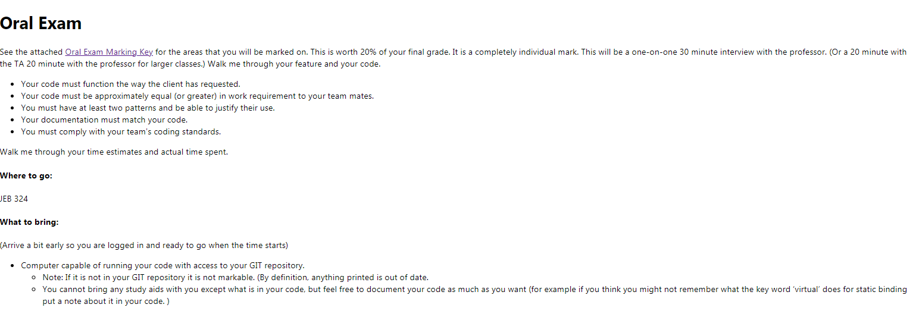
Oral Exam Requirements
(info on BC website)
No study aids but you can comment your code as much as you want!
Casey Jensen | MILCCN

Slide 6
GRASP
General Responsibility Assignment Software Patterns
a set of "nine fundamental principles in object design and responsibility assignment"
9 principles
Controller
Creator
Indirection
Information expert
Low coupling
High cohesion
Polymorphism
Protected variations
Pure fabrication
These patterns solve some software problems common to many software development projects
Casey Jensen | MILCCN

Slide 7
GRASP
General Responsibility Assignment Software Patterns
a set of "nine fundamental principles in object design and responsibility assignment"
Design of objects?
We are initially trained to think of objects in terms of data structures and algorithms but with Responsibility driven design (RDD) this shifts in treating objects as having roles and responsibilities
Responsibility driven design (RDD) - asks questions like
What are an object's responsibilities?
What are an objects roles?
What are an object's collaborations?
Objects become - service providers, information holders, coordinators, controllers, etc
Casey Jensen | MILCCN

Slide 8
GRASP
What is an object responsibility?
A responsibility is defined as “a contract or obligation of a classifier.”
Responsibilities are related to the obligations of an object in terms of its behavior
Two types of responsibility
Knowing responsibilities of an object include:
knowing about private encapsulated data knowing about related objects
knowing about things it can derive or calculate
Doing responsibilities of an object include:
doing something itself, such as creating an object or
doing a calculation
initiating action in other objects
controlling and coordinating activities in other objects
A responsibility is not the same thing as a method
Casey Jensen | MILCCN

Slide 9
GRASP
Methods are implemented to fulfill responsibilities
Responsibilities are implemented using methods that either act alone or collaborate with other methods and objects
Assumption:
responsibilities are implemented by means of methods
the larger the granularity of responsibility, the larger the number of methods
this may entail an object interacting with itself or with other objects
Therefore:
fulfilling responsibilities requires collaborations amongst different methods and objects
Casey Jensen | MILCCN

Slide 10
GRASP
Lots of information BUT the whole point:
One of the reasons object oriented approaches are so valuable is that they allow the design of the software to closely match the real world
This makes it easier to understand what the code is doing, given an understanding of the problem domain
Experienced object-oriented developers (and other software developers) build up a repertoire of both general principles and idiomatic solutions that guide them in the creation of software
GRASP is a methodical approach to object oriented design created by Craig Larman
GRASP is patterns of assigning responsibilities
GRASP recognizes that responsibility assignment is something we already do
All the diagrams we made were about assigning responsibilities
Casey Jensen | MILCCN

Slide 11
Low coupling pattern
Coupling: the degree to which each program module relies on the other module
Another definition: degree of interaction between two modules
Another definition: Coupling is a measure of how strongly one element is connected to, has knowledge of, or
relies on other elements
The problem: How can our design support
Low dependency?
Low change impact?
Increased reuse?
The solution:
Assign a responsibility so that coupling remains low
Use this principle to evaluate alternative assignment of responsibilities.
5 levels
5. Data (Best)
4. Stamp
3. Control
2. Common
1. Content (Worst)
Casey Jensen | MILCCN

Slide 12


Low coupling pattern
Starting at the worst: Content Coupling
Definition: one module can modify the data of another module, or control flow is passed from one module to the other module. This is the worst form of coupling
public class Enemy
{
private int health;
public void TakeDamage(int damage)
{
health -= damage;
}
}
public class Player
{
public void AttackEnemy(Enemy enemy)
{
enemy.health -= 10;
}
}
// Directly modifying Enemy's private health
public class Enemy
{
public void TakeDamage(int damage)
{
health -= damage;
}
}
public class Player
{
public void AttackEnemy(Enemy enemy)
{
enemy.TakeDamage(10);
}
}
//use public methods to access the health variable
Casey Jensen | MILCCN
Notes:
Why this is bad:
Tight Coupling: Changes to the Enemy class (like adding new health modifiers) would require immediate changes to the Player class as well, making maintenance difficult.
How to avoid content coupling:
Use public methods: Instead of directly accessing private variables, the Enemy should expose a public method to update its health:

Slide 13
Low coupling pattern
Next: Common Coupling
Definition: The modules have shared data such as global data structures. The changes in global data mean tracing back to all modules which access that data to evaluate the effect of the change.
//global variable
public static int PlayerHealth = 100;
public void AttackPlayer() //enemy class
{
PlayerHealth -= 20;
// Directly modifying the global variable
}
public void ApplyHealthBoost() //powerup class
{
PlayerHealth += 50;
// Also modifying the global variable
}
public class Player //create player class
{
public int Health { get; set; }
}
public void AttackPlayer(Player Player) //enemy class
{
player.health -= 20;
}
public void ApplyHealthBoost(Player Player) //powerup class
{
player.health -= 50;
}
Casey Jensen | MILCCN
Notes:
Why this is bad (common coupling):
Difficult to maintain:
If you need to change how health is managed (e.g., add a new health mechanic), you have to update every single place in the code that accesses the global "PlayerHealth" variable, leading to potential bugs and inconsistencies.
Hard to debug:
When a problem arises with player health, it can be difficult to pinpoint which part of the code is causing the issue because multiple entities are directly modifying the same global variable.
How to fix it (loose coupling):
Use a dedicated "Player" class.

Slide 14
Low coupling pattern
Next: Control Coupling
Definition: one module passes an element of control to the other
Example
control-switch passed as an argument
Why is this bad?
modules are not independent
module b must know the internal structure of module affects reusability
Casey Jensen | MILCCN
Notes:
Why this is bad (common coupling):
Difficult to maintain:
If you need to change how health is managed (e.g., add a new health mechanic), you have to update every single place in the code that accesses the global "PlayerHealth" variable, leading to potential bugs and inconsistencies.
Hard to debug:
When a problem arises with player health, it can be difficult to pinpoint which part of the code is causing the issue because multiple entities are directly modifying the same global variable.
How to fix it (loose coupling):
Use a dedicated "Player" class.

Slide 15
Low coupling pattern
Next: Stamp Coupling
Definition: data structure is passed as parameter, but called module operates on only some of individual components
public class ItemManager
{
public Dictionary <string, int> Inventory {get; set;}
public void AddItem(string itemName, int quantity)
{
Inventory.Add(itemName, quantity);
}
}
public class Player
{
public ItemManager Inventory { get; set; }
public void UseItem(string itemName)
{
// Player only needs to access one item from the Inventory
if (Inventory.Inventory.ContainsKey(itemName))
{
// ... use logic
}
}
}
public interface IInventory
{
int GetItemCount(string itemName);
bool HasItem(string itemName);
}
public class Player
{
private readonly IInventory _inventory;
public Player(IInventory inventory)
{
_inventory = inventory;
}
public void UseItem(string itemName)
{
if (_inventory.HasItem(itemName))
{
// ... use logic
}
}
}
// Implementation of IInventory could be a class like "PlayerInventory" which only exposes the necessary data
Casey Jensen | MILCCN
Notes:
Problem:
In this example, the "Player" class directly holds a reference to the entire "ItemManager" object including its "Inventory" dictionary, even though it only needs to access a small part of it to perform actions like using an item. This creates tight coupling, making it harder to modify the "ItemManager" without affecting the "Player" class.
How to Improve (Loose Coupling):
Use Interfaces and Data Transfer Objects (DTOs):

Slide 16
Low coupling pattern
Next: Data Coupling (BEST) - This lowers the dependencies between modules
Definition: every argument is either a simple argument or a data structure in which all elements are used by the called module
public class Player
{
public void AttackEnemy(Enemy enemy)
{
enemy.Health -= 10;
// Player directly modifies Enemy's health
}
}
public class Enemy
{
public int Health { get; set; }
}
public class Player
{
public void AttackEnemy(Enemy enemy)
{
enemy.TakeDamage(10); // Player only needs to know about the "TakeDamage" method
}
}
public class Enemy
{
public int Health { get; set; }
public void TakeDamage(int damage)
{
Health -= damage;
}
}
Casey Jensen | MILCCN
Notes:
A classic example of data coupling in a C# game would be if a "Player" class directly accesses and modifies the health value stored in an "Enemy" class, meaning the Player needs to know the exact structure of the Enemy class to manipulate its health, creating a tight coupling between the two entities; a better approach would be to have the Enemy expose a method like "TakeDamage" that the Player can call, passing only the damage amount, thus achieving looser coupling

Slide 17
High Cohesion
Classes should be designed to do one thing, and one thing only
Think of it as a functional unit - every part of a screwdriver should be optimized for driving screws
Any kind of a multitool is a compromise
Daniel Franks | Teal Team 6
Notes:
Introduce self/team and Creator Pattern
Like factory GoF pattern but with responsibility
This pattern gives another object the responsibility of instantiating other objects that don’t instantiate themselves
This pattern is used to help decrease coupling

Slide 18
Types of Cohesion
Coincidental - parts are grouped completely arbitrarily (grab bag)
Logical - parts all do the same thing, more or less (three wrenches, five sockets and an oil filter wrench)
Temporal - parts are all called at the same time (funnel, oil filter wrench, drip pan)
Procedural - parts act in order (same as above, but add a X wrench and a jack because you rotate your tires when you change your oil like you’re supposed to, right?)
Communicational - parts all need the same data (drill bits, screwdriver bits)
Sequential - one part picks up where another leaves off (saw, grinder, sander)
Functional - parts work together to do one thing (socket kit with ratchet)
Perfect - you cannot simplify this any further (one, singular, 10mm wrench)
Daniel Franks | Teal Team 6
Notes:
Introduce self/team and Creator Pattern
Like factory GoF pattern but with responsibility
This pattern gives another object the responsibility of instantiating other objects that don’t instantiate themselves
This pattern is used to help decrease coupling

Slide 19


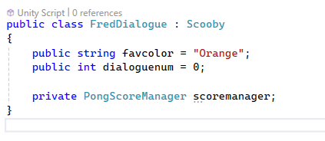

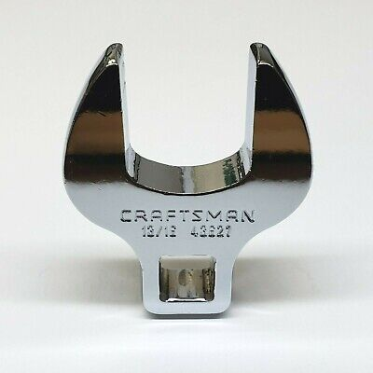

Coincidental Cohesion
Daniel Franks | Teal Team 6
Notes:
There’s no organization. Completely random.

Slide 20
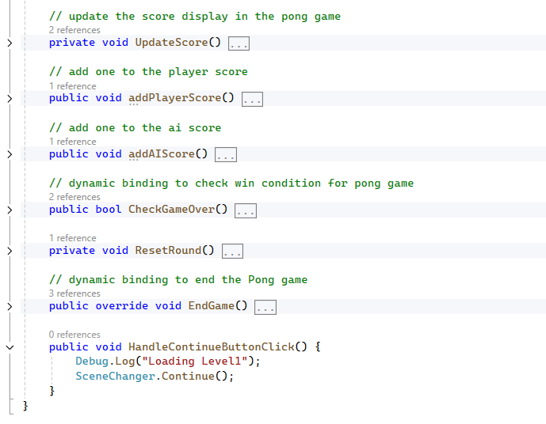


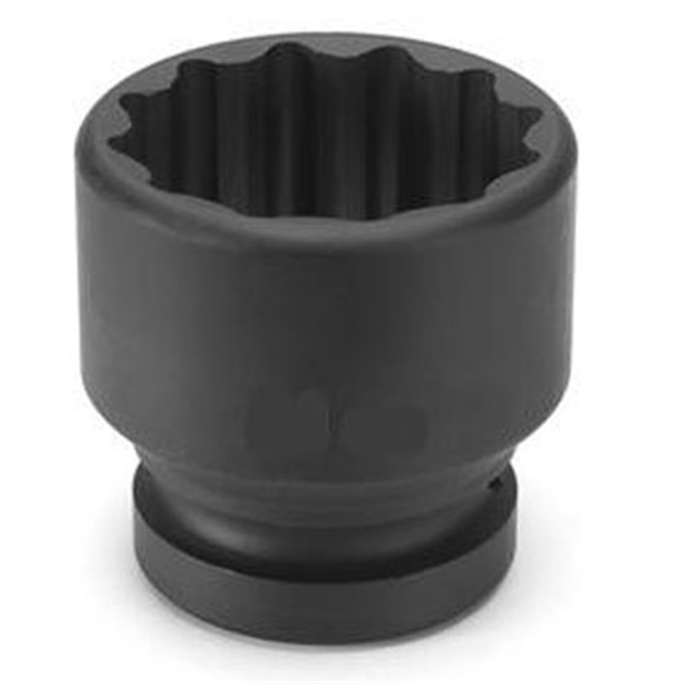
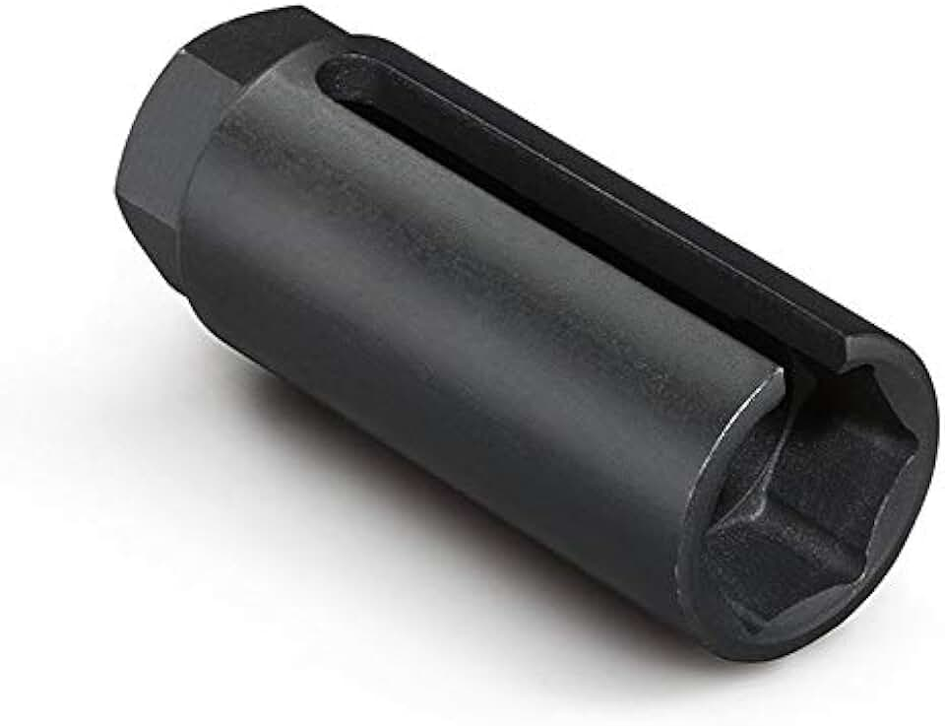

Logical Cohesion
Daniel Franks | Teal Team 6
Notes:
At least they all sorta do the same thing (check scores, turn things)

Slide 21
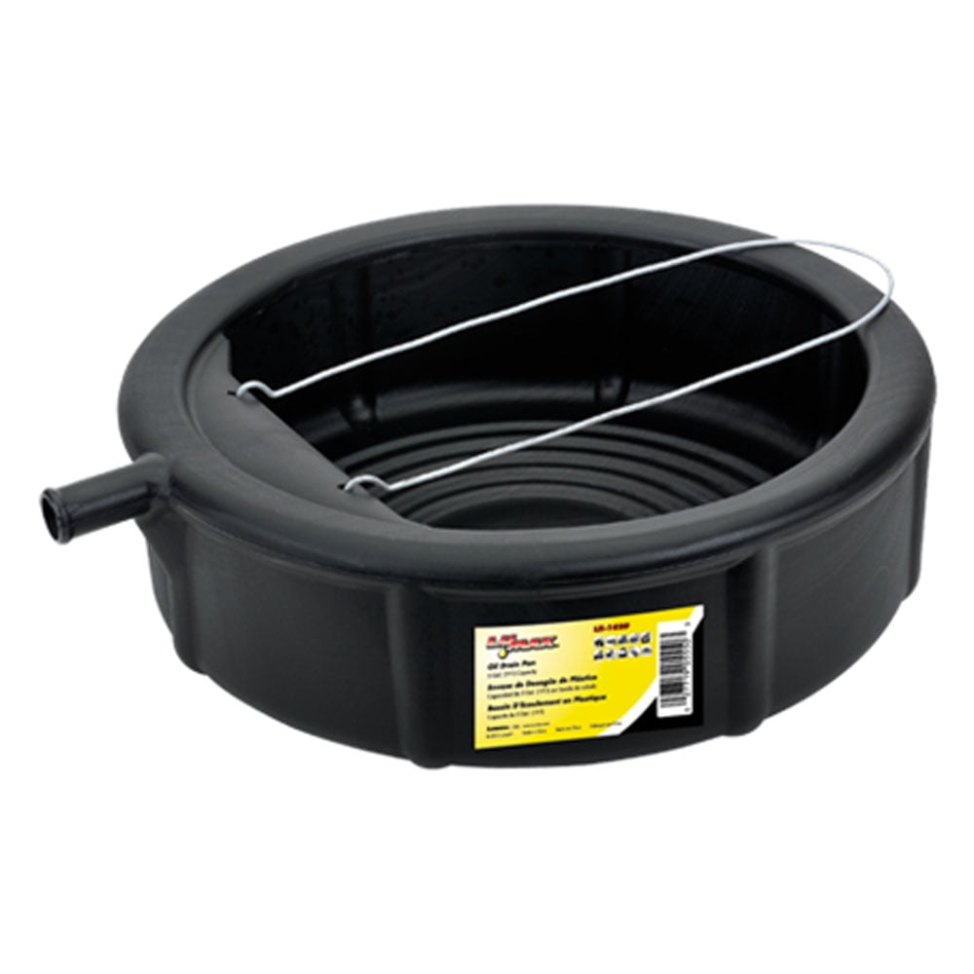

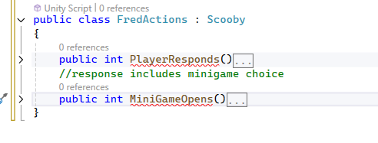

Temporal Cohesion
Daniel Franks | Teal Team 6
Notes:
All happen at the same time

Slide 22
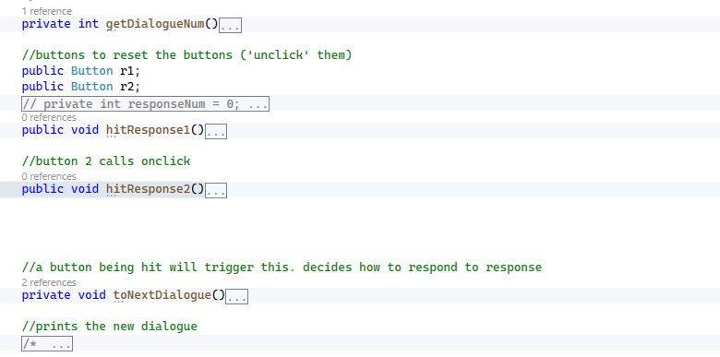
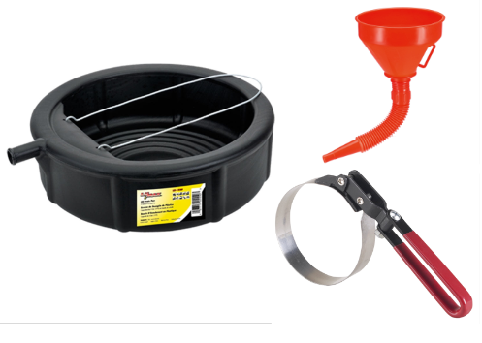



Procedural Cohesion
Daniel Franks | Teal Team 6
Notes:
These things happen in order, one two three four five

Slide 23
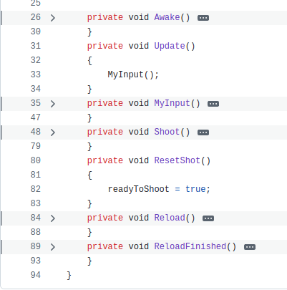



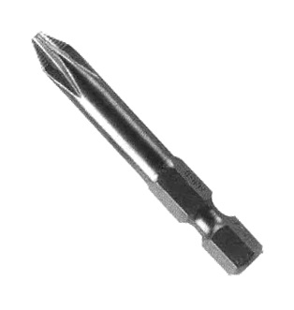
Communicational Cohesion
Daniel Franks | Teal Team 6
Notes:
Everything here operates on the same data

Slide 24
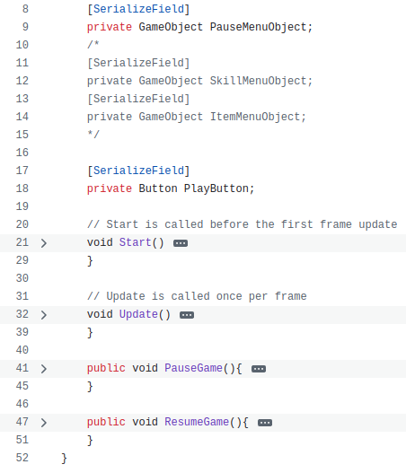


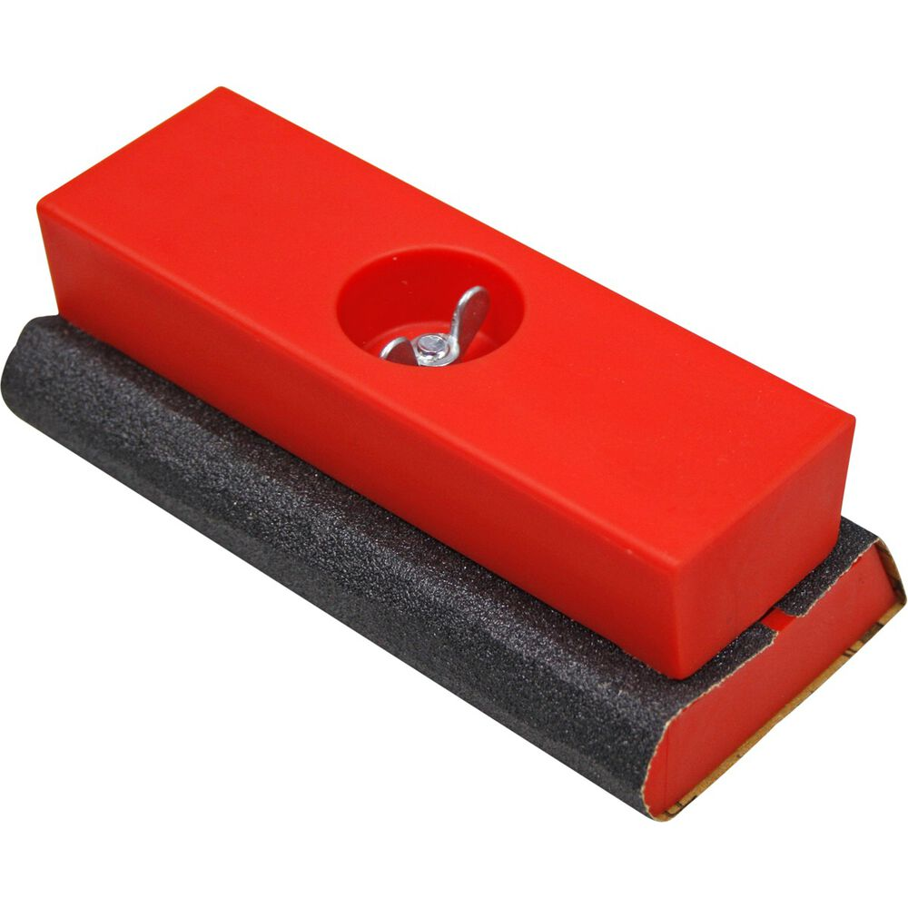
Sequential Cohesion
Daniel Franks | Teal Team 6
Notes:
Sequential cohesion follows a sort of assembly line notion, one part picks up where another leaves off

Slide 25
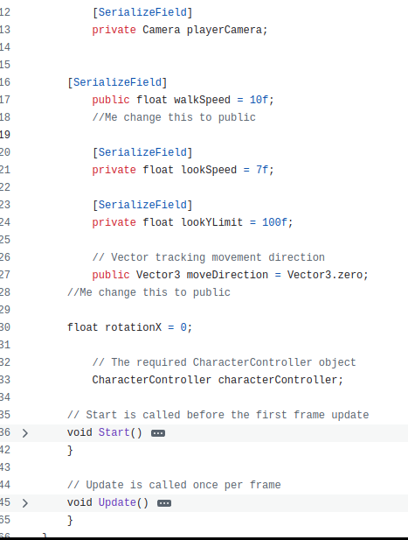
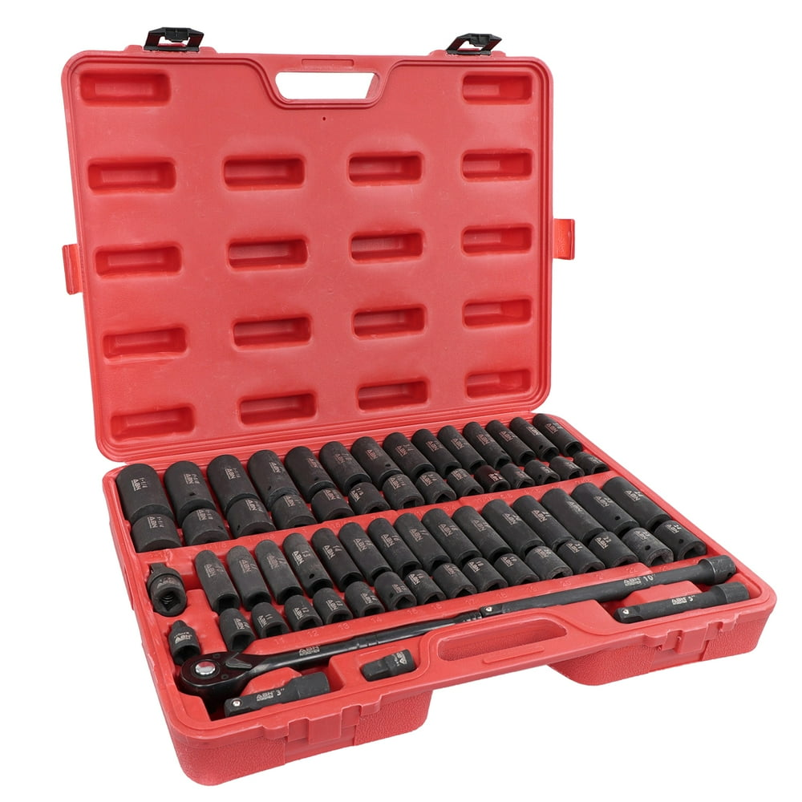
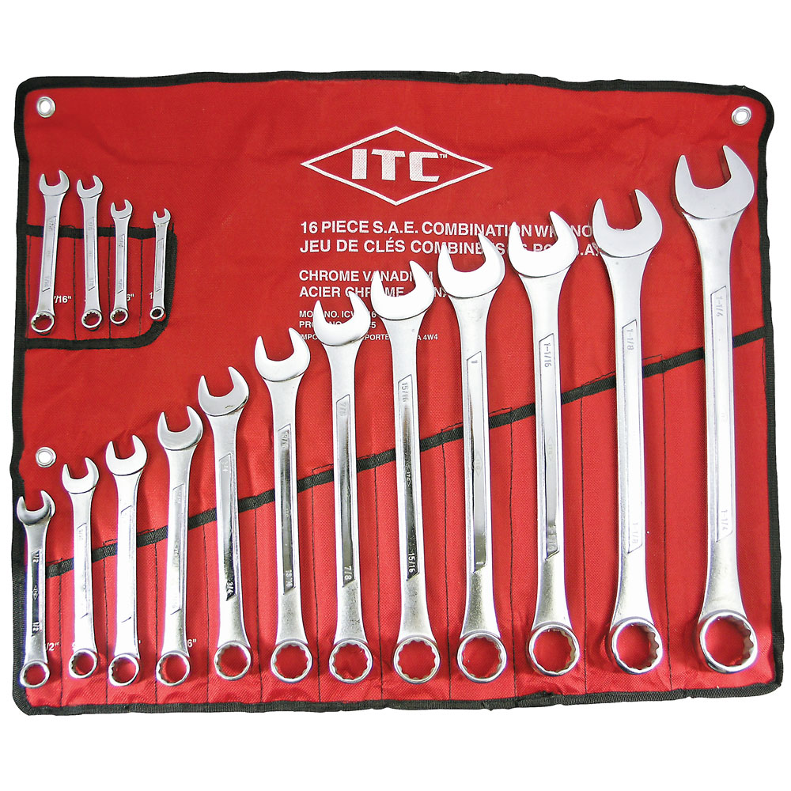
Functional Cohesion
Daniel Franks | Teal Team 6
Notes:
All the parts work together to achieve one thing, pretty much what you want

Slide 26
imagine
in your mind
the perfect class
nirvana
Notes:
A child could understand it. No unintentional side effects. Can’t be subverted by malicious actors. Will never break anyone else’s code, nor can it be broken by anyone else’s code.

Slide 27
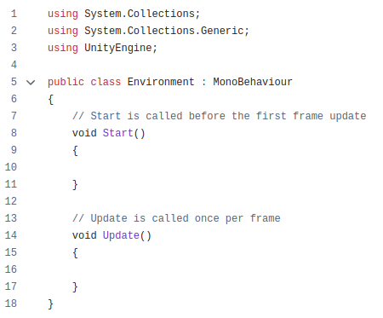

Perfect Cohesion
Daniel Franks | Teal Team 6

Slide 28
Creator Pattern
Similar to factory GoF pattern
Instantiate objects that don’t instantiate themselves
Decreases coupling
Austin Walker | Team 5 Guys
Notes:
Introduce self/team and Creator Pattern
Like factory GoF pattern but with responsibility
This pattern gives another object the responsibility of instantiating other objects that don’t instantiate themselves
This pattern is used to help decrease coupling

Slide 29
Selecting a Creator
Goal: Select object with already strong coupling
Each criteria indicates higher coupling
Criteria
B Contains A
B Records A
B Holds Data to be Passed to A
B Closely Uses A
Austin Walker | Team 5 Guys
Notes:
Goal of selecting a creator:
Find an object that already has strong coupling with the thing that needs to be created
Each criteria for the creator indicate a higher degree of coupling
Object B (The one that will create) contains object A (The one that needs to be created)
Implies a hierarchical relationship with composition or aggregation
Object B records object A
Object B keeps tabs on object A for some reason, but that is where the relationship ends
Can have references to object A
Object B closely uses object A
Key characteristics:
Frequent interactions
High dependency
Direct comuniction
Object B holds data that object A needs
So it will be passed from b to a
Should be self explainitory

Slide 30
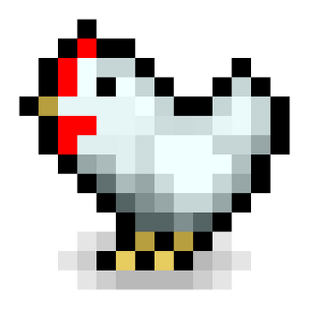
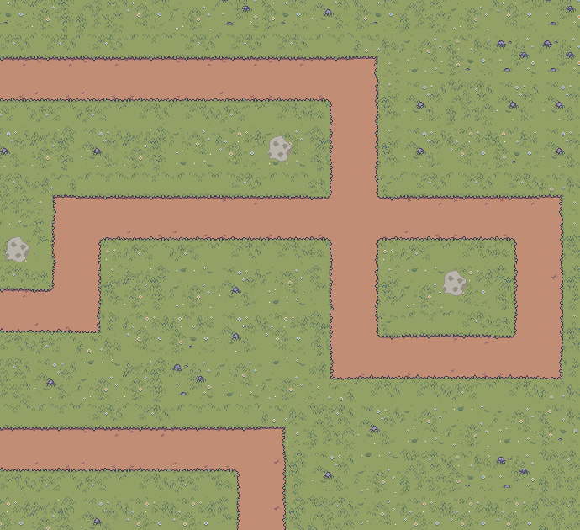
Example Problem
Chicken objects need to be instantiated
Who will do it?
Chicken factory
Level manager
Round manager
B Contains A
B Records A
B Closely Uses A
B Holds Data Needed by A
Austin Walker | Team 5 Guys
Notes:
From Team 5 Guys project
TL6 (Clayton) is on enemies (the chickens), but the chickens don’t instantiate themselves (click to “instantiate chickens”)
They don’t have the necessary difficulty data
Who will be given the responsibility? Could:
Create an object based on Factory pattern
Increases coupling since other objects already have this data
Level manager
Contains base difficulty (difficulty for the entire level)
Round manager
Calculates stuff for round difficulty based on base difficulty and current round number
As round number increases so does difficulty

Slide 31
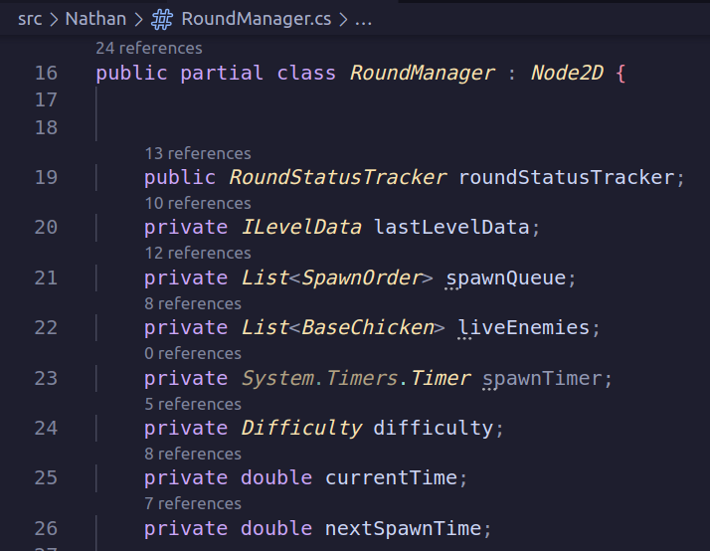
Example Problem Continued
B Contains A
B Records A
B Holds Data Needed by A
B Closely Uses A
Austin Walker | Team 5 Guys
Notes:
After some analysis we found that:
Round manager (object B) records chickens (object A)
If no chickens on screen and no more to spawn, round ends
Round manager closely uses chickens
The round manager figures out the spawn queue
Round manager holds data needed by chickens
Round manager holds an instance of level data, which contains a path that the chickens need to be connected to
This data is needed for other reasons too, the base difficulty, it just so happens to be there
Round manager doesn’t contain object A though
An example would be a book in a library
Books are necessary for a libary

Slide 32
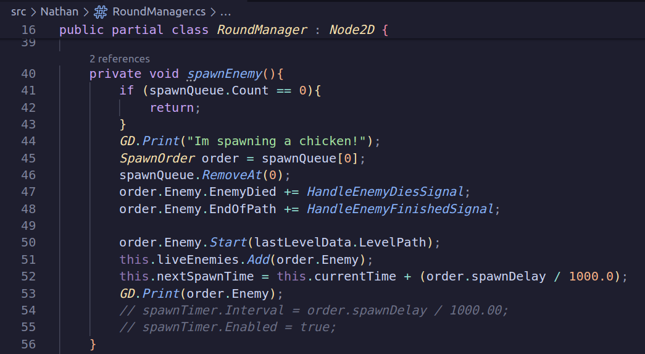
Solution
Austin Walker | Team 5 Guys
Notes:
The solution was to give the round manager the responsibility of instantiating the chickens, by creating the spawnEnemy function for it.

Slide 33
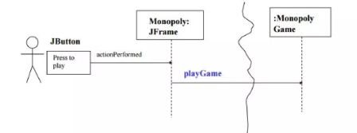
Controller
What is it?
The Controller pattern assigns the responsibility of handling system events to a non-UI class that represents either the entire system or a specific use case. A controller object is a non-UI entity tasked with receiving or handling system events.
Controller
System Event
UI
Shawn Young | Nautilus
Notes:
Player starts the interaction. System Event playGame gets called, Monopoly Game would be an appropriate Controller in this example.

Slide 34
Controller - Problem and Solution
What first object beyond the UI layer receives and coordinates (“controls”) a system event?
Assign a responsibility to a class based on one of the following:
Class is “root object” for overall system or major subsystem. (Façade Controller)
A new class based on use case name. (Use Case Controller)
Example: Imagine a banking system with use cases like "Open Account," "Close Account," "Transfer Funds," and "Check Balance."
A Facade Controller (BankSystemController) could act as a centralized entry point that receives system events for all of these use cases and delegates to them appropriately.
A Use Case Controller might handle a specific use case like OpenAccountController or TransferFundsController, each focusing solely on the tasks related to that individual operation.
Shawn Young | Nautilus
Notes:
This is usually applied to the actions in our Sequence Diagrams. System events are generated by some GUI, we do not write to the GUI. We don’t have window, view or document classes. GUI is meant to “delegate” tasks to the system.

Slide 35
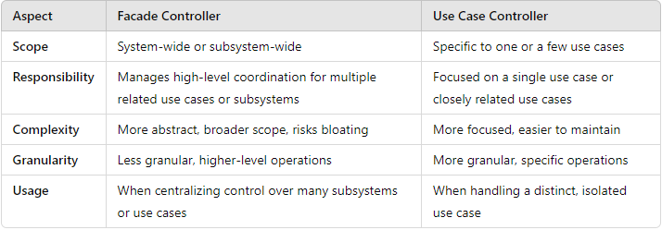
Controller - Some Issues
Most common issue is to have too few controllers making them “bloated controllers”, this leads to low cohesion. You must have a balance between having too many controllers and too few controllers.
Examples:
Single controller classes for every single event (Façade Controller)
Controller performs many of the events itself rather than delegating work
Controller maintains a lot of state information about the system (i.e. variables and attributes)
Shawn Young | Nautilus
Notes:
In this table you can see the differences between a Facade Controller and Use Case Controller, Facade is more broad, and Use Case is much more specific.

Slide 36
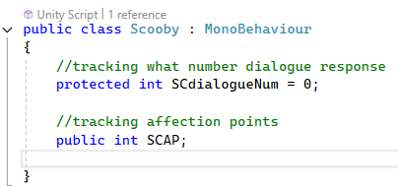
Polymorphism
Problem: Handling objects based on the class they belong to and creating pluggable software components
Solution: When behaviors vary depending on class, the differences need to be assigned to specific classes where the behaviors differ
Emily Smith | Penguine

Slide 37
Information Expert
Problem: What is the principle for assigning responsibilities to objects?
Solution: Responsibilities should be assigned to the class with the most information
Amara Jeide | Make It Awesome

Slide 38
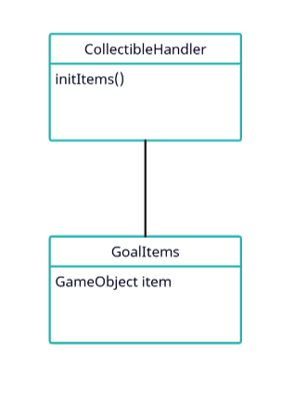
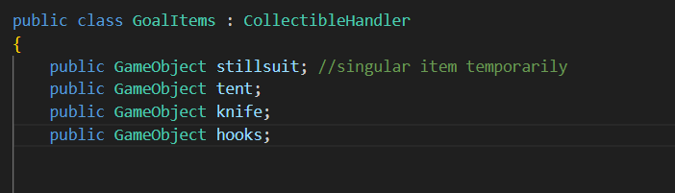
Information Expert - Example
GoalItems is the “expert” that handles tracking items and calculations with them
Amara Jeide | Make It Awesome

Slide 39
Protected Variations
Problem: Design a system where variations in one element does not affect other objects
Solution: Create an interface to make variable objects appear invariable
Amara Jeide | Make It Awesome

Slide 40
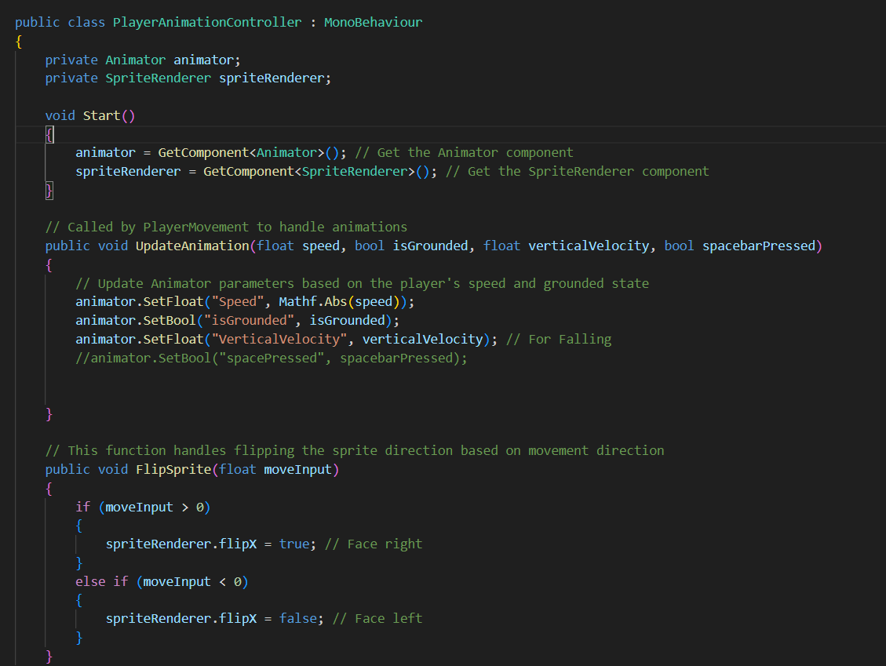
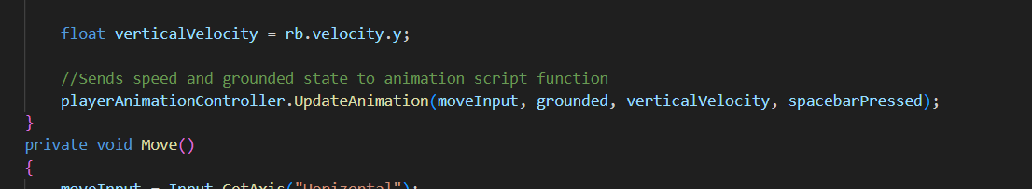
Protected Variations - Example
Interface
Protects variable code
Amara Jeide | Make It Awesome

Slide 41
Pure Fabrications
Problem: Where is responsibility assigned when you run the risk of violating low coupling or high cohesion?
Solution: Assign a highly cohesive set of responsibilities to a new class created explicitly for that purpose.
Taran Haug - Tappa Tappa Keyboard
Notes:
Where is responsibility assigned, when trying to maintain low coupling/high cohesion?
Pure Fabrications solve this problem by creating a new class, and assigning it a highly cohesive set of responsibilities.

Slide 42
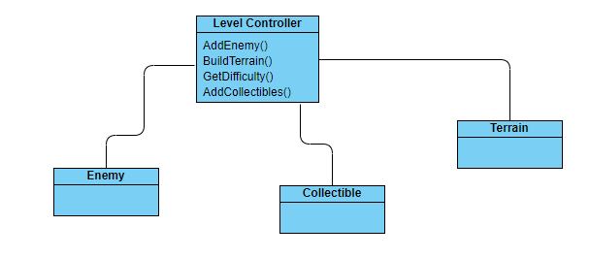
Pure Fabrications - Example
Low Cohesion
Taran Haug - Tappa Tappa Keyboard
Notes:
Here we have an example of a class that isn’t very cohesive.
Most methods are based around generating a level, but some of them are specific to configuring enemies.

Slide 43
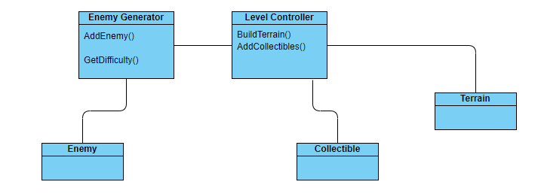
Pure Fabrications - Example (cont.)
Pure Fabrication: Higher Cohesion, Lower Coupling
Taran Haug - Tappa Tappa Keyboard
Notes:
Here we have added a pure fabrication, which handles the enemy related functions, while the original class handles other responsibilities.
Using this pattern reduces coupling, making it easier to add enemies separate from the level, while also increasing cohesion by making each class more focused.

Slide 44
Indirection
Problem: Where to assign responsibility to avoid direct coupling between two or more classes?
Solution: Assign responsibility to an intermediary class to mediate between other classes.
Taran Haug - Tappa Tappa Keyboard
Notes:
Indirection is similar to pure fabrications, but focuses on the problem of avoiding direct coupling between classes.
The solution indirection offers is to create an intermediary class to mediate between other classes.

Slide 45
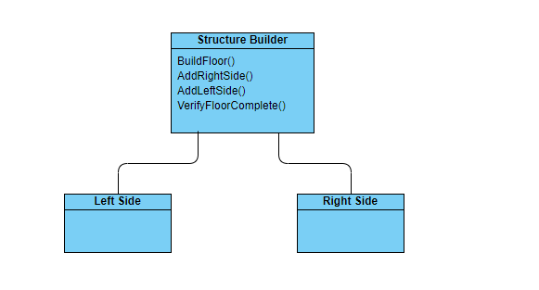
Indirection - Example
High Coupling
Taran Haug - Tappa Tappa Keyboard
Notes:
In this example, we have a class which build a structure one floor at a time, and each floor is constructed of two pieces.
This is very high coupling since each piece cannot be used without the others.

Slide 46
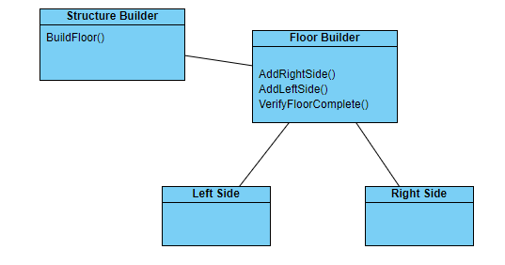
Indirection - Example (cont.)
Indirection: Lower Coupling
Taran Haug - Tappa Tappa Keyboard
Notes:
With inderection, we create as new class to build each floor, while the original class adds them to the structure.
This reduces coupling, since the floor builder could be repurposed for a different kind of structure, and the structure builder could use different kinds of floors.

Slide 47
Coding Standards, Why?
They provide a guide for developers to format their code to improve consistency and readability.

Slide 48
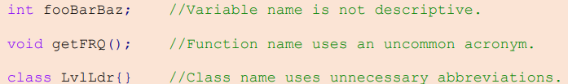
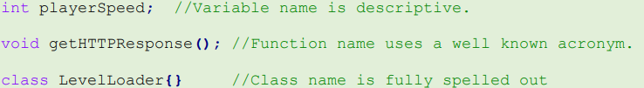
General Naming Rules
Names should clearly convey the purpose of the item being named. Developers should avoid using abbreviations and acronyms that may not be immediately recognizable to others. As stated in the Google C++ Style guide, “…an abbreviation is probably OK if it's listed in Wikipedia.”

Slide 49
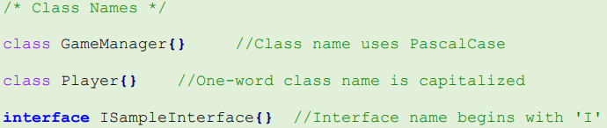
Naming Classes
Class names should adhere to the general naming conventions described in the previous slide and should be formatted in PascalCase.
For interfaces, names should begin with the letter "I." The code below illustrates examples of appropriate class names.

Slide 50
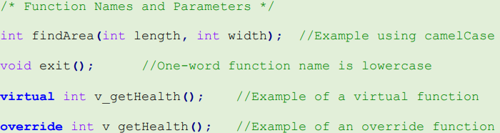
Naming Functions
Function names and parameters should conform to the general naming rules specified previously, using camelCase for their formatting.
Additionally, names for virtual and override functions should start with the prefix "v_."

Slide 51
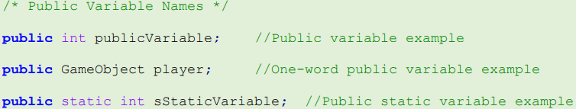
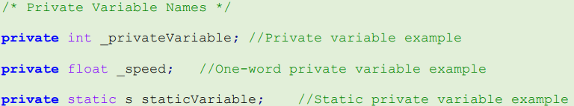
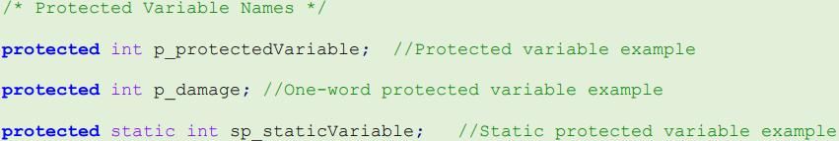
Naming Public, Private and Protected Variables
Public variables should be named using camelCase.
Private variables should begin with an underscore, followed by camelCase for the remainder of the name. If a private variable is
Protected variables should begin with the p_ prefix and then use camelCase for the rest of the name.
If a variable is static, it should always start with the "s" prefix, prioritized over other prefixes.

Slide 52
Constant Variables
Constant variable names should be written in all uppercase letters, with underscores separating each word.

Slide 53
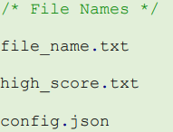
File Names and Exceptions
While following the general naming rules, file names should be all lowercase with underscores between each word.
Naming exceptions can be made if a variable has a common meaning or purpose this name doesn’t need to follow the naming standards. For example, the variables used for iterating in a for loop.

Slide 54
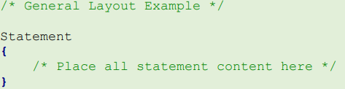
General Layout Rules
Indentations should always be 4 spaces (a tab).
Statements that involve curly braces, such as functions, classes, conditional statements and loops, the following rules apply:
1. The opening brace should be placed on the line below the statement.
2. The closing brace should be positioned on the line after the last line of the statement's content.
3. All content within a statement should be enclosed between the opening and closing braces, with no other content on the same line as either brace.
Notes:
This section details how to organize and format code to improve consistency and readability.

Slide 55
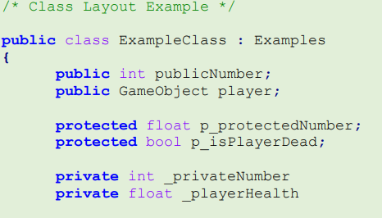
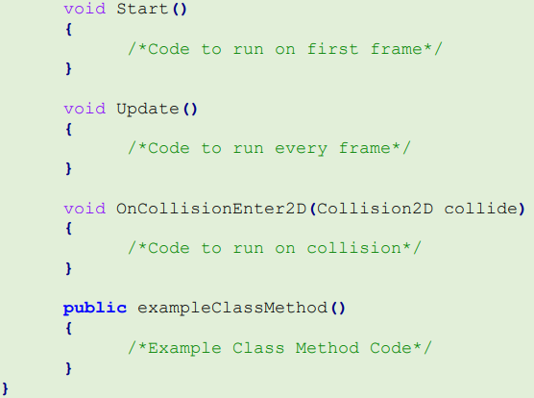
Class Layout
Classes should be designed to minimize coupling and maximize cohesion. When creating classes, ensure that the content within a class is related (high cohesion) and that only essential data is able to be passed between objects (low coupling).
Classes should follow the general layout rules, and should be laid out in this order:
Class data members, arranged from most to least visible (i.e., public, protected, private).
The Unity Start() method (if applicable).
The Unity Update() method (if applicable).
Other Unity methods, such as Awake() or OnCollisionEnter2D().
Any custom functions.
Additionally, each distinct element within a class should be separated by an empty line.

Slide 56
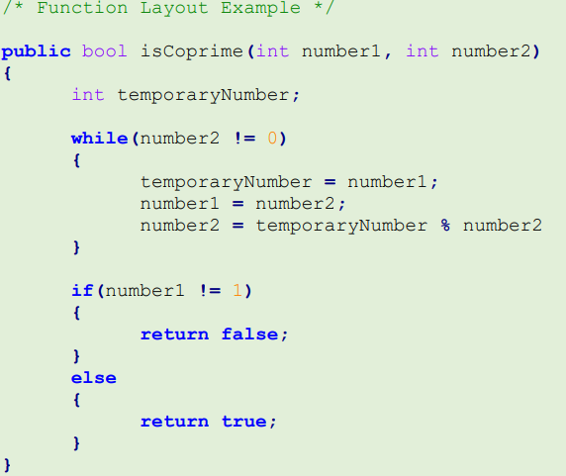
Function Layout
Functions will follow the general layout rules, parameters for the functions will be separated by a comma and space. Functions variable definitions should be placed at the beginning of the function followed by an empty line.
Functions should be designed to minimize coupling and maximize cohesion. When writing a function, keep it concise and focused on a specific task (high cohesion). If a function requires parameters, make sure that only the required data is passed in (low coupling).

Slide 57
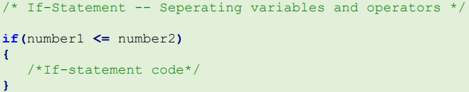
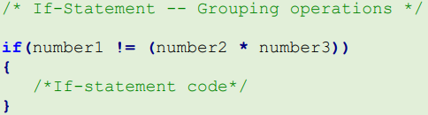
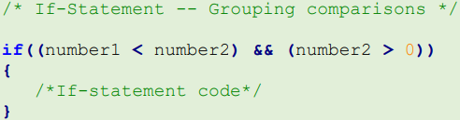
If-Statement Layout
Readable and easy to understand.
1. Space between all variables and operators.
2. Operations needing to take place should be placed inside parentheses.
3. Multiple comparisons should be placed inside parentheses.

Slide 58
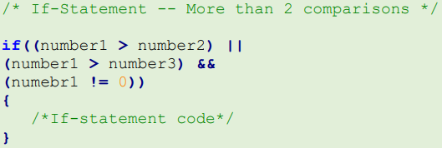
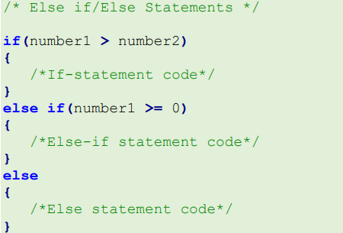
If-Statement Layout (cont.)
4. More than 2 comparisons, each comparison needs to be placed on a separate line with the operator at the end of the line
5. If more than 3 else if statements are needed consider using a switch statement instead.

Slide 59

Switch Statement Layout
Follow the general layout rules like always.
When writing a switch statement make sure to include a default statement.

Slide 60

While and Do-While Loop Layout
The same layout rules are required for while and do-while loops, the only additional key is that they must be able to escape their loop.

Slide 61

For Loop Layout and Nesting Statements
For loops should follow the general layout rules.When defining the initialization, condition, and post-loop housekeeping, use spaces between variables and operators, except when using the `++` or `--` operators.
Anything beyond 4 levels deep of nesting should be avoided if at all possible.

Slide 62

Code Comments - Multi-line Comments
Comments play a crucial role in communicating ideas to other developers. When writing comments, prioritize explaining why a section of code exists rather than simply stating what it does. Include comments whenever there are complex elements that require additional clarification, such as intricate if statements or REGEX expressions.
For comments written on a new line, use the `/* Comment */` syntax. If a comment spans multiple lines, each new line should begin with an asterisk. Put each idea within the comment on its own line for better readability.

Slide 63

In-line Comments
If inline comments are used, they should be concise and to the point, using the `//` syntax. When multiple inline comments appear in a row, ensure that they are properly aligned for clarity.

Slide 64

Function Headings
Each function in your code should be preceded by a function header comment. This comment should provide a high-level overview of the function and explain how it interacts with other functions, variables, and classes.

Slide 65

File Heading
At the beginning of each script, there should be a file header that describes the purpose of the file. This comment must include the developer’s name, role, project name, and class relationships like inheritance that are in the file.

Slide 66

Let the Code Roasting Begin!

Slide 67
Just kidding…
TL4’s didn’t do coding standards before we started working on projects. You all should be roasting us.

Slide 68
Gantt Roasts

Slide 69






Team 5 Guys
Notes:
Chart doesn’t automatically update (left top)
Programming too broad (left middle)
Platformer? Recording time not for this project (left bottom)
We’ve met for the MVP before I swear (right)

Slide 70







Tappa Tappa Keyboard
Patterns where?
Notes:
Only 15 hours (top)
No work done yet (top)
Well you ain’t getting paid for those meetings (bottom left)
No patterns in chart tasks (bottom right)

Slide 71



Make It Awesome
Notes:
Patterns??
Dynamic binding??
Instant task completion
No meetings :(((
Made 2 days ago

Slide 72





Penguine

Slide 73











Nautilus
Gantt Chart made 3 days ago???
No patterns!
Example:
Shawns:
ALL

Slide 74





MILCCN
So many colors, so little work
Me looking for the patterns and dynamic binding work items
Notes:
All these colors but barely any work done?? Top
All this group does is code and go to meetings - no training or overhead cost - right small one
Patterns and dynamic binding - we don’t know her - bottom

Slide 75





Teal Team 6
Extremely violent colors
Help plz
Half of the time isn’t even tracked we drew this up in like 30 minutes last night
What the heck is a jira and why are there so many people in it
Notes:
Bro I haven’t done anything :sob: all the time is just guesstimation, the fancy tools never actually got implemented, all I have to show for my efforts is cat gifs

